Slide 1
PRACTICAL DEEP LEARNING WITH BAYESIAN PRINCIPLES
Final Presentation
EE5111 : Estimation Theory
OM SHRI PRASATH - EE17B113
TAMIL SUDARAVAN - EE18B119
KAOUSHEIK - EE18B134
RAMANAN - EE18B145
Notes:
‹#›

Slide 2
WHY BAYESIAN PRINCIPLES IN DEEP LEARNING
DEEP LEARNING :
Overfitting
Sequential learning - Forgetting past knowledge
Lack of confidence estimates & robustness estimates
BAYESIAN PRINCIPLES :
Uncertainty - Posterior distribution
Sequential learning - Bayes Rule
Overfitting - Bayesian model averaging
BAYESIAN LEARNING - HEAVY COMPUTATIONAL REQUIREMENTS!
Notes:
‹#›

Slide 3
VARIATIONAL INFERENCE
Variational Inference (VI) - Reduces computational cost of posterior
We can be reduce search space from the entire distribution (P) to the distribution in focus (Q) which lowers the computational complexity of calculating posteriors.
Apply parametric approximation & optimize Evidence Lower Bound (ELBO)
If q(w) - Gaussian Distribution, the gradient update form resembles traditional optimizer update form like Stochastic Gradient
Notes:
‹#›

Slide 4
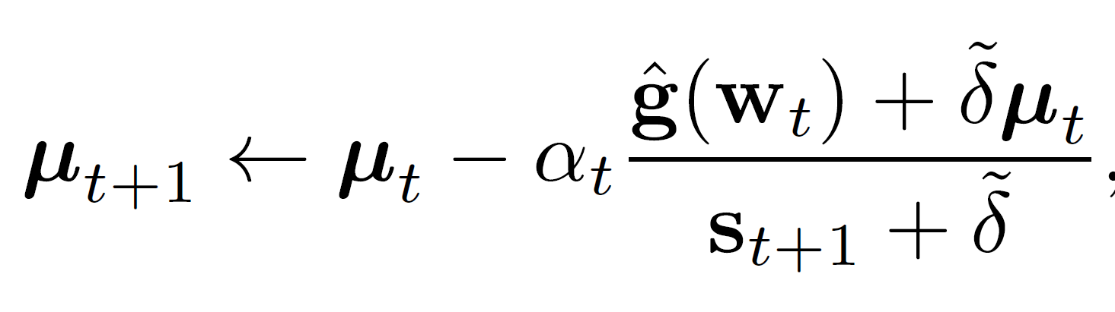
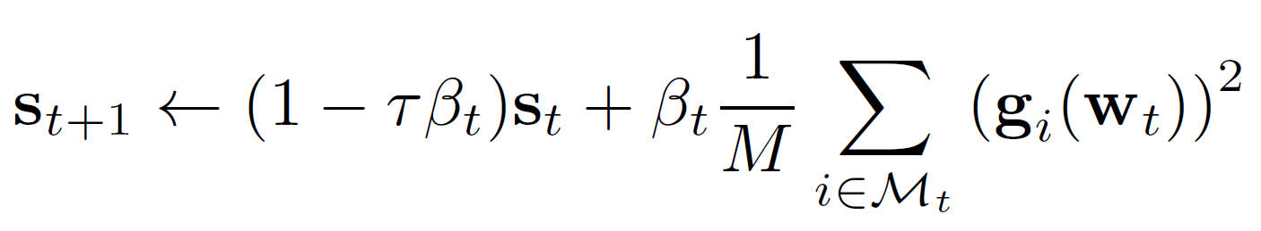
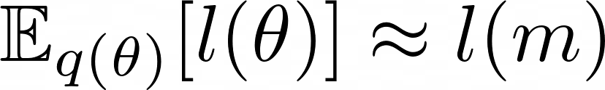



VOGN (VARIATIONAL ONLINE GAUSS-NEWTON)
Variational Online Gauss-Newton method (VOGN) : RMSprop with “Bayesian Learning Rule”.
Bayesian Learning Rules:
“Global” to “Local” approximation, i.e. is removed.
Natural parameter ( ) updated using Gauss-Newton approximation
SG update uses gradient magnitude as .
Above step needs additional calculation ⇒ VOGN a bit slower than Adam but expected to give better variance estimates.
Can use same DL techniques like momentum initialization, learning rate scheduling, etc. as used in normal DL optimizers.

Slide 5

UNCERTAINTY IN PREDICTIONS
Estimation of uncertainty of prediction allows us to take informed decision on the result of the prediction.
Bayesian models have better uncertainty estimates compared to traditional DL models since using multiple estimators for prediction provides uncertainty of the model on the data via the variance in the predictions of each estimator.
Gaussian approximation in VOGN generates multiple models with different weights via MC samples from Gaussian model whose predictions can be used to determine the uncertainty of the model on the data.
Predictive Entropy: It is given as,
This metric is used to quantify uncertainty for both in-distribution and out-of-distribution data.

Slide 6
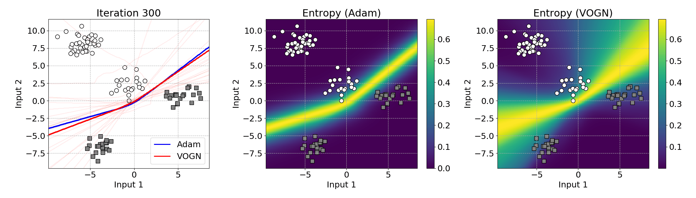
RESULTS
MLP on 2-D classifier
Notes:
‹#›

Slide 7
ACTIVE LEARNING
A special case of machine learning in which a learning algorithm can interactively query a user (or some other information source) to label new data points with the desired outputs
Useful in cases where labelling of data is costly/difficult.
Let T be the total set of all data under consideration.
During each iteration, i, T is broken up into three subsets :
T_{K,i}: Data points where the label is known.
T_{U,i}: Data points where the label is unknown.
T_{C,i}: A subset of T_{U,i} that is chosen to be labeled.
Current research - Best method to choose the data points for T_{C,i}.
Uncertainty sampling - Common technique used for updating T_{C,i}.
VOGN predictive entropy can be used as measure of uncertainty for extracting uncertain samples.

Slide 8
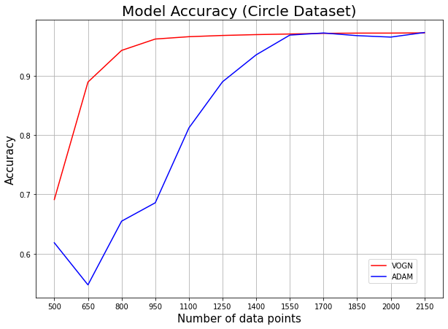
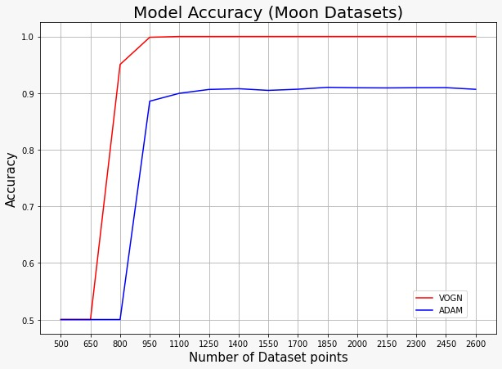
ACTIVE LEARNING ON 2D DATASETS USING VOGN
We performed active learning using VOGN for classification task on two types of 2D datasets, Moon Dataset and Circle Dataset, and compared the results of the same with Adam
Starting with 500 points, we trained a model using Adam and VOGN, and added 150 new points which had the highest entropy after each iteration.

Slide 9
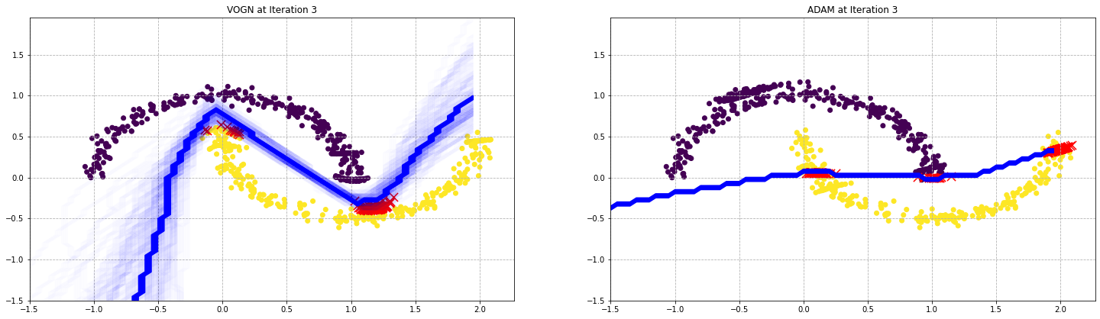
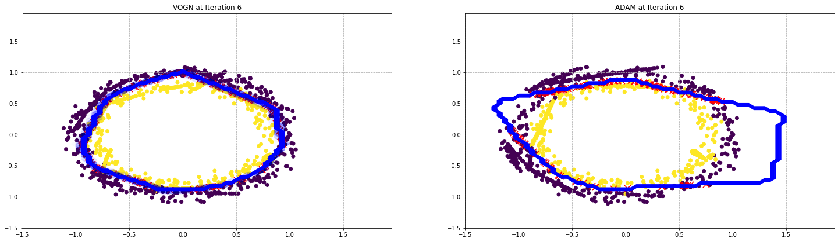
RESULTS OF 2-D DATASETS

Slide 10
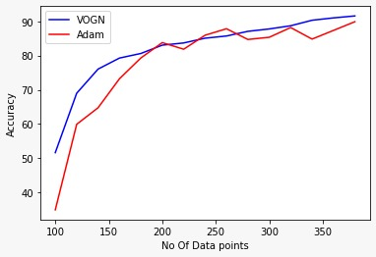
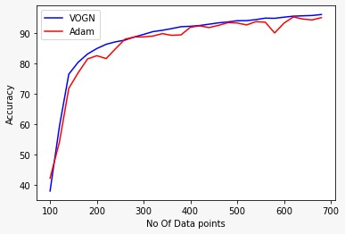
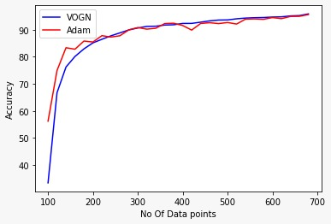
ACTIVE LEARNING ON MNIST DATASET
We performed Active Learning using VOGN on MNIST Dataset for 10 classes and compared the same with the ADAM.
Starting with 100 points, we trained both Adam and VOGN, calculated the high entropy points and added top 20 points on each iteration.

Slide 11
INFERENCES
In case of 2D dataset, we can see that VOGN takes fewer no. of iterations than ADAM to achieve optimal validation accuracy. This is because, VOGN recognizes data points which are more important to decide optimal decision boundary.
In case of MNIST dataset, we can see that VOGN learns steadily through Active Learning whereas ADAM seems to have fluctuations in accuracy with increase in the number of data points.
We can infer that VOGN selects best data points through Active Learning to train the model whereas ADAM’s fluctuations in accuracy shows that it’s not able to find the best points for training the model effectively.

